Slide 1
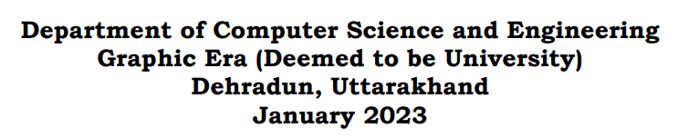

FACE RECOGNITION SYSTEM
Made By- Ruudra Amola
Univ Roll No- 2016972
Mentor- Mr. Saurabh Kumar Mishra
(Assistant Professor)

Slide 2
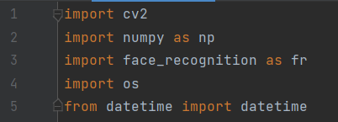
INTRODUCTION
Problem Statement:
The main purpose of this project is to build a face recognition system using machine learning techniques. Further an extension is introduced in the system which also monitors attendance using webcam in real-time.
Software and Tools/modules used:
Language Used- Python (Version 3.11.1)
Python is a high-level, general-purpose programming language that is widely used for web development, data analysis, artificial intelligence, scientific computing, and many other applications.
Modules Used-

Slide 3
Cv2 module: The cv2 module is a part of the Python programming language's OpenCV library ("Open Computer Vision"), which is a collection of tools for working with visual data.
NumPy module: With NumPy, you can easily create arrays, which is a data structure that allows you to store multiple values in a single variable.
Face-recognition module: Recognize and manipulate faces from Python or from the command line with the world’s simplest face recognition library.
os module: The OS module in Python provides functions for interacting with the operating system. This module provides a portable way of using operating system-dependent functionality.
datetime module: Python Datetime module supplies classes to work with date and time. These classes provide several functions to deal with dates, times, and time intervals.
IDE used- PyCharm (Community edition Version 2022.3)
PyCharm is an integrated development environment used for programming in Python. It provides code analysis, a graphical debugger, an integrated unit tester, integration with version control system and supports web development tools. PyCharm is developed by JetBrains.

Slide 4
METHODOLOGY
This project mainly focuses on practical implementation of face recognition technology to track attendance and store the names and the time of presence in front of the webcam of a specific face and detects it based on the images stored in a database folder along with the names of the persons whose image is present in the folder.
It then stores name and time in a csv file and then creates an excel sheet to store the attendance records of the faces it detected in front of the web cam. The main library used in the project is OpenCV.
Open-CV: The concept of OpenCV was put forth by Gary Bradski which had the ability to perform on multi-level framework. OpenCV has several significant abilities as well as utilities which appears from the outset. The OpenCV helps in recognizing the frontal face of the person and creates XML documents for several areas such as the parts of the body.

Slide 5
Brief Understanding of the Code:-
Data collection:
The project uses a set of images which it matches with the image it sees on the web camera at runtime. It matches the web cam image with each image in the dataset folder by iterating through the folder.
The dataset of images which I have used in the code is not a pre-existing dataset anywhere on the internet and is created using my personal images.
Pre-Processing:
def findImageEncodings(images):
The images in the database are being encoded into a set of eigen values which exist for each image in the folder and then these eigen values are used to generate the distances in of each image in the database to the image it sees on the webcam.
The findImageEncodings() function does the work of image encoding using the face_recognition module and takes input parameter which is the list of images in the folder.
This function returns a list of image encodings called encodeList[].

Slide 6
def trackAttendance(name):
The other main user-defined function used in the program is the trackAttendance() function which exactly marks the attendance in the csv file along with the time it takes while detecting a particular face on the webcam.
This function uses a csv file which is opened in read only mode initially and then reads the csv file for previous entries of the name of the person whose face has been detected by the cam.

Slide 7
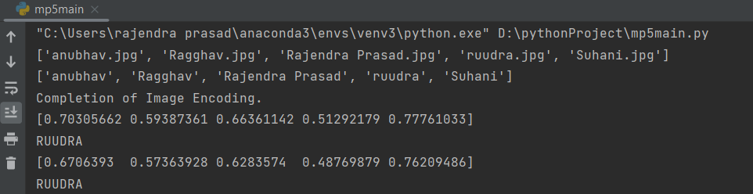
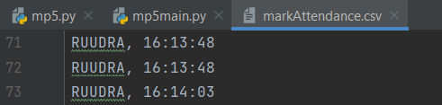
RESULTS AND DISCUSSIONS
In the above output terminal, the first line of output is the names of all detected images in the dataset folder in a list. The next line of output is the same list as the image names, but it is in the appended format.
Then as soon as my face appears on the web cam, the system calculates the distances of each image present in the database with the face that it detects on the webcam.
And then writes the name and the time of appearance in the csv file named “markAttendance.csv” that I have imported in the program as seen in the following image.

Slide 8
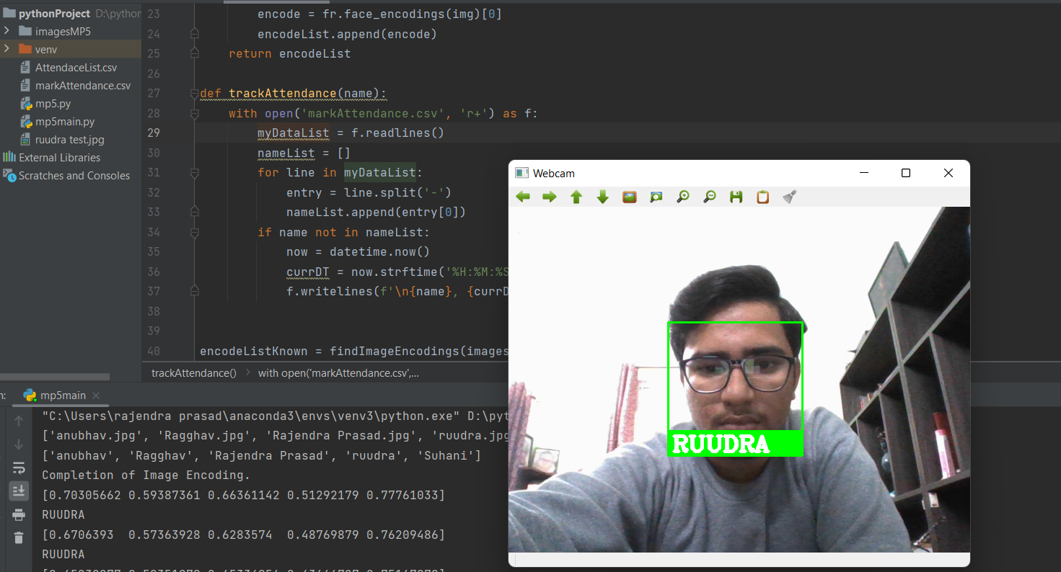
Final output of the Program:-
This is the main output screen after the detection of the face. The above image of the whole screen shows the detection of the face along with a rectangle around my face and label of the name it has detected from the list of names extracted from the image database folder.

Slide 9
CONCLUSION AND FUTURE WORK
Face recognition systems are currently associated with many top technological companies and industries making the work of face recognition easier.
The use of python programming and OpenCV makes it an easier and handy tool or system which can be made by anyone according to their requirement.
The proposed system discussed in this project will be helpful for many as it is user friendly and cost-efficient system.
Advantages:
The advantages of the face recognition system include faster processing, automation of the identity, breach of privacy, massive data storage, enhanced security, real time face recognition of students in schools and colleges, employees at offices, smartphone unlock and many more.
Disadvantages:
Few disadvantages in this system include the costing, or the funding, very good cameras of high definition are required, poor image quality may limit the effectiveness of this system, size of the image will matter because it becomes difficult to recognize the face in small images.

Slide 10

THANK YOU!

